Slide 1
Sales Performance Analysis & Business Insights
Task-4
ApexPlanet Internship
July 2026

Slide 2
Business Objective
This project analyses sales data to identify business trends, customer purchasing behaviour, top-performing products, and regional sales patterns. It also validates key findings through statistical testing and provides actionable recommendations to improve business performance.
July 2026

Slide 3
Dataset Overview
Metric | Value
Total Records | 1000
Columns | 12
Orders | 1000
Total Sales | ₹139.4 M
✔ Data cleaned and preprocessed ✔ Missing values handled ✔ Dataset ready for analysis ✔ Used for Power BI & statistical testing
July 2026

Slide 4
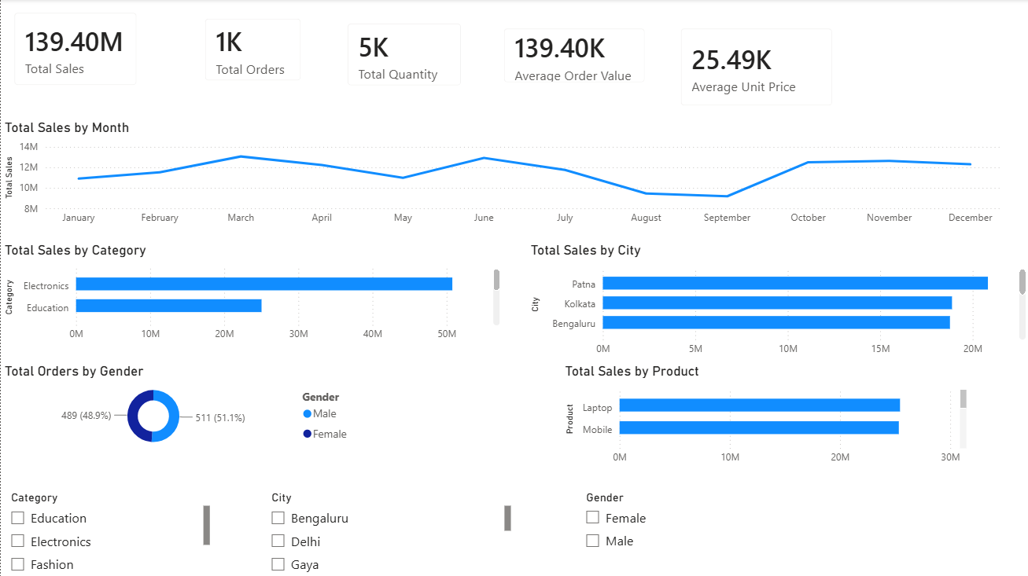
Dashboard Overview
Figure 1: Interactive Power BI dashboard summarizing sales performance by month, category, city, product, and customer demographics.
July 2026

Slide 5
Key Business Insights
Sales Performance
Total Sales: ₹139.4M
Average Order Value: ₹139.4K
Peak Months: April & November
Business Insights
Top Category: Electronics
Top Products: Laptop & Mobile
Top City: Patna
July 2026

Slide 6
Business Hypothesis
Hypothesis
H₀ (Null Hypothesis) There is no statistically significant difference in average sales between male and female customers.
H₁ (Alternative Hypothesis) There is a statistically significant difference in average sales between male and female customers.
Statistical Test Used • Independent Samples T-Test • Significance Level (α): 0.05
July 2026

Slide 7
Statistical Analysis & Results
Metric | Value
Average Sales (Male) | ₹141,807
Average Sales (Female) | ₹136,883
Statistical Test | Independent Samples T-Test
Significance Level (α) | 0.05
P-value | 0.495
Interpretation
P-value = 0.495
Since 0.495 > 0.05, we fail to reject the null hypothesis.
There is no statistically significant difference in average spending between male and female customers.
Business Conclusion
Customer spending is not significantly influenced by gender. Therefore, business strategies should focus on products, cities, and seasonal trends rather than gender-specific marketing.
July 2026

Slide 8
Business Recommendations
Product Strategy
Increase investment in the Electronics category due to its strong revenue contribution.
Bundle Laptop & Mobile offers to increase average order value.
Focus inventory planning on high-demand products to avoid stock shortages.
Sales Strategy
Launch promotions during low-sales months.
Replicate successful strategies across cities.
Introduce seasonal discounts during festive periods to maximize revenue.
Business Strategy
Continue monitoring KPIs using Power BI.
Make decisions based on statistical analysis.
Regularly review customer purchasing trends to optimize marketing strategies.
Call to Action: Implement these recommendations to improve sales performance, optimize marketing strategies, and support data-driven decision-making.
July 2026

Slide 9
Conclusion
Successfully analyzed sales data using Power BI and basic statistical methods.
Identified Electronics as the highest revenue-generating category, with Laptop & Mobile as the top-performing products.
Sales trends revealed peak and low-performing periods, enabling better planning for promotions and inventory.
Statistical testing showed that gender does not significantly influence average customer spending (p-value > 0.05).
The analysis demonstrates how data-driven decision-making can improve sales performance, optimize marketing strategies, and support future business growth.
Business Takeaway: Organizations should prioritize product performance, seasonal demand, and regional trends over gender-based marketing to maximize business growth.
July 2026

Slide 10
THANK YOU
July 2026

